Slide 1
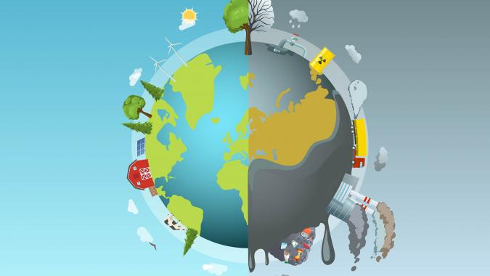
Does Richer Mean Greener ?
Being Rich vs Being Clean
This Photo by Unknown Author is licensed under CC BY-SA

Slide 2
What motivated us ?
To understand what true Development means ?
Create Awareness - Equal distribution of responsibility to protect our planet
To analyse the correlation (if any) between economical prosperity with environmental sustainability.

Slide 3

Our Questions
Q1. Do developed countries recycle more than other developing countries ? Does GDP play a part ?
Q2. Do developed countries have a bigger carbon footprint ?
Q3. Does a country’s GDP relate to its clean energy generation ?

Slide 4
Our Data Set and APIs
The World Factbook (thx Kaggle!)
“The World Factbook provides basic intelligence on the history, people, government, economy, energy, geography, environment, communications, transportation, military, terrorism, and transnational issues for 266 world entities.” – cia.gov/the-world-factbook/
Economic
Environmental
Energy Production
Demographic
Geographic
Reliable (source)
Recent (updates)
Relevant (info)
R… Navigable

Slide 5


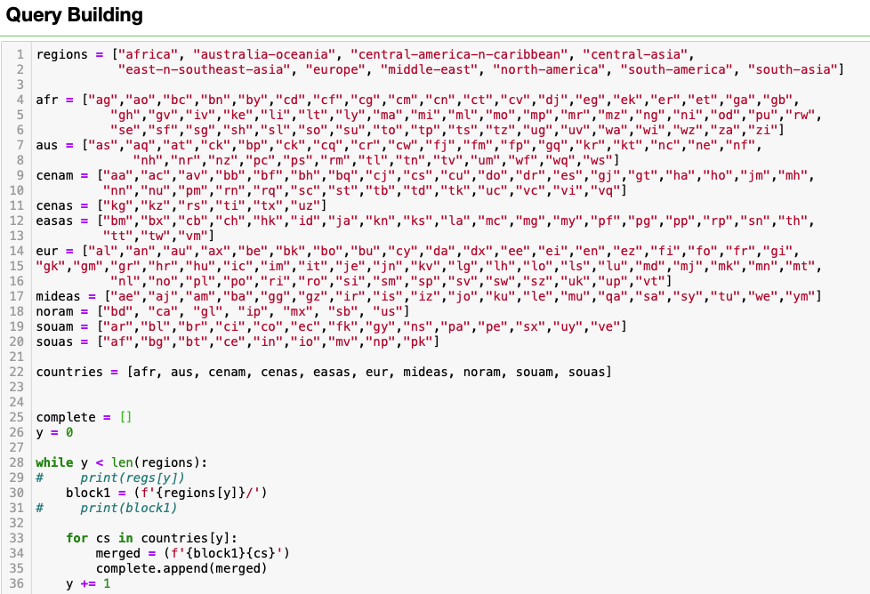
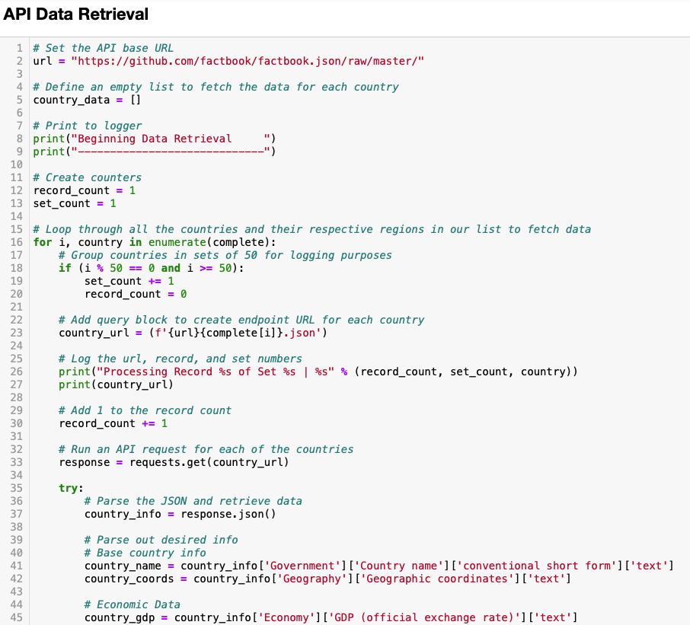
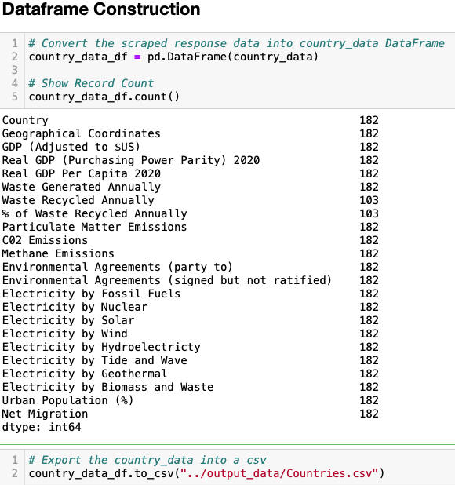
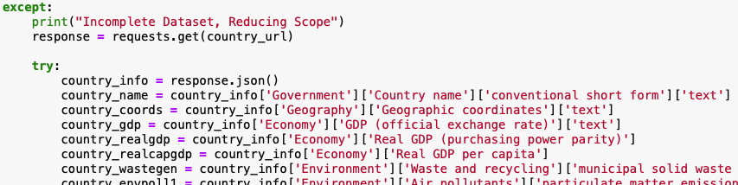
Picture of code

Slide 6
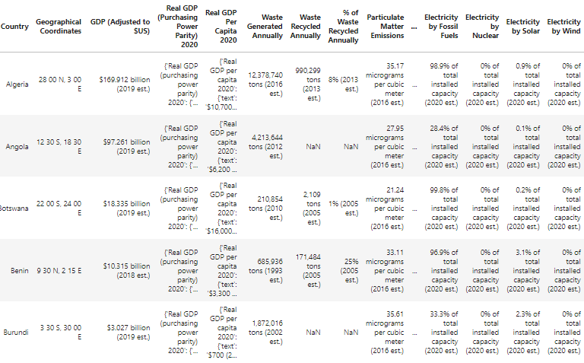
Cleaning the Data
Data Inconsistency
GDP (Adjusted to $US)
(2019 est.) vs (2018 est.)
Null Value
Fillna
Columns interpreted as text
Wrong Data Type

Slide 7
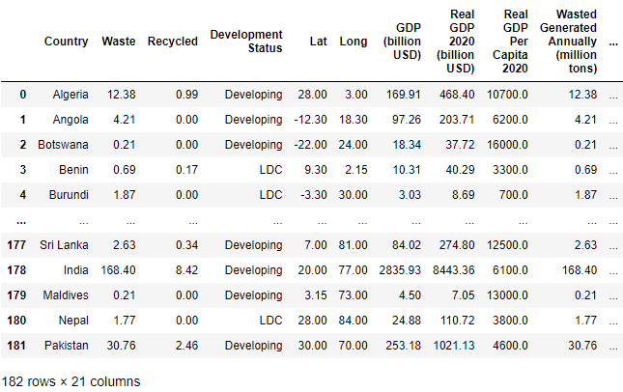
Method & Result
Data Inconsistency
Conditional
Null Value
Fillna
Float
Wrong Data Type
For & While Loop
Split and Replace
Split and Replace

Slide 8

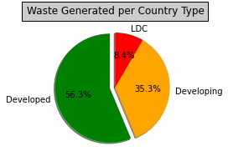
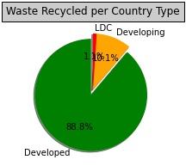



GDP vs Waste (generated and recycled)

Slide 9
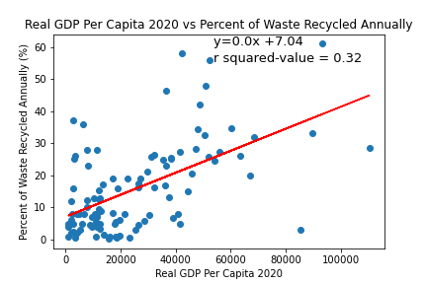
Pearson Correlation= 0.56552,
Significance = 5.90404e-10

Slide 10
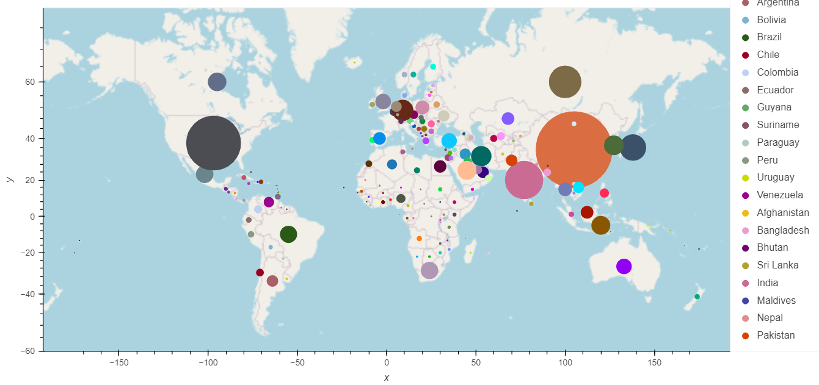
Air pollutants vs GDP
CO2 emissions map

Slide 11
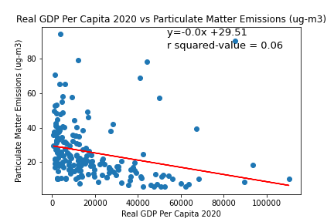
Pearson Correlation= - 0.25003
Significance = 0.000664

Slide 12
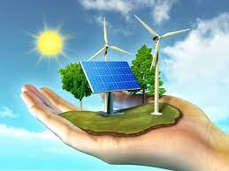
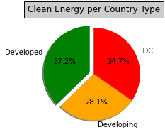
GDP vs Electricity generation

Slide 13
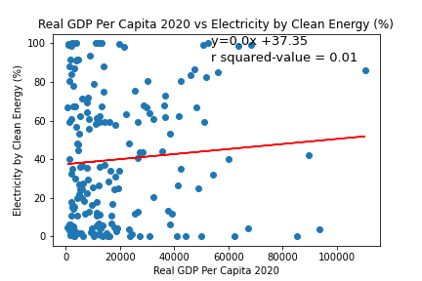
Pearson Correlation= 0.07762, Significance = 0.29762

